Slide 1


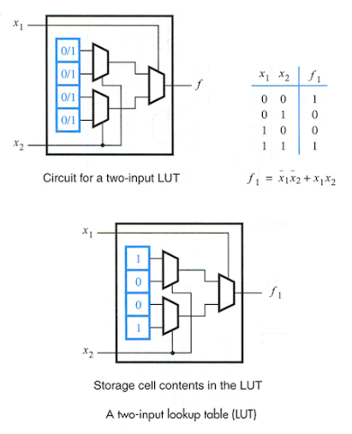
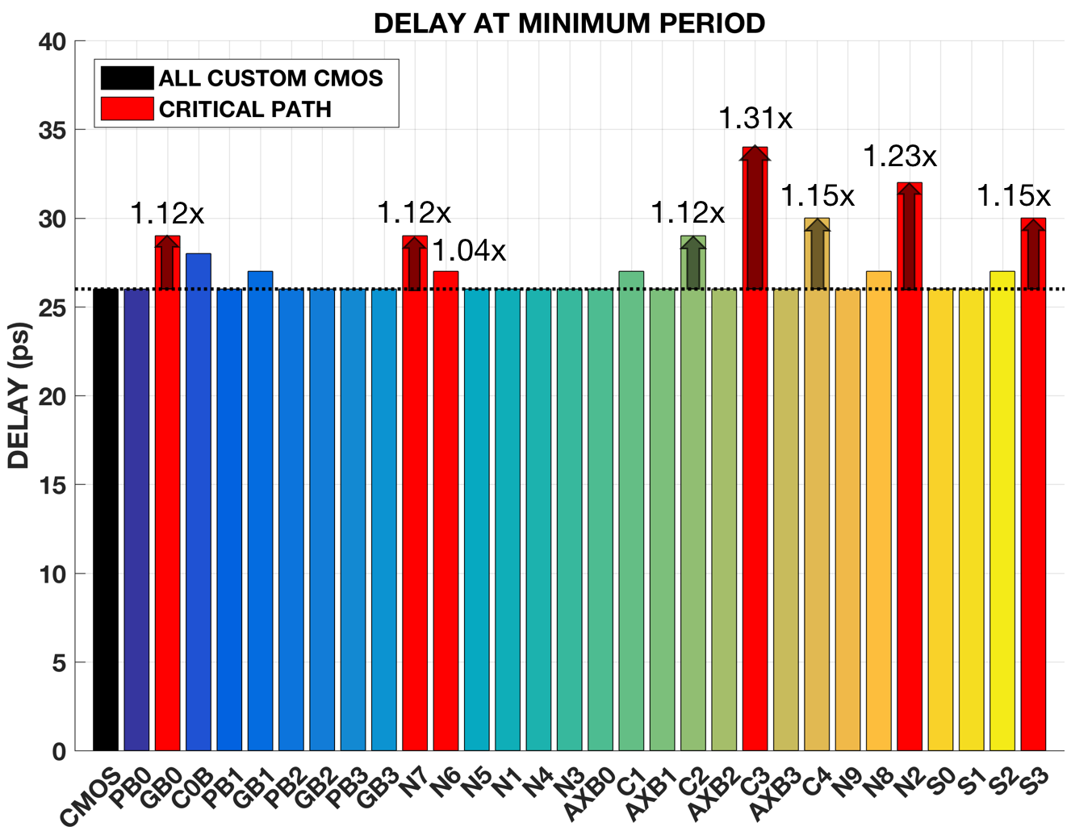
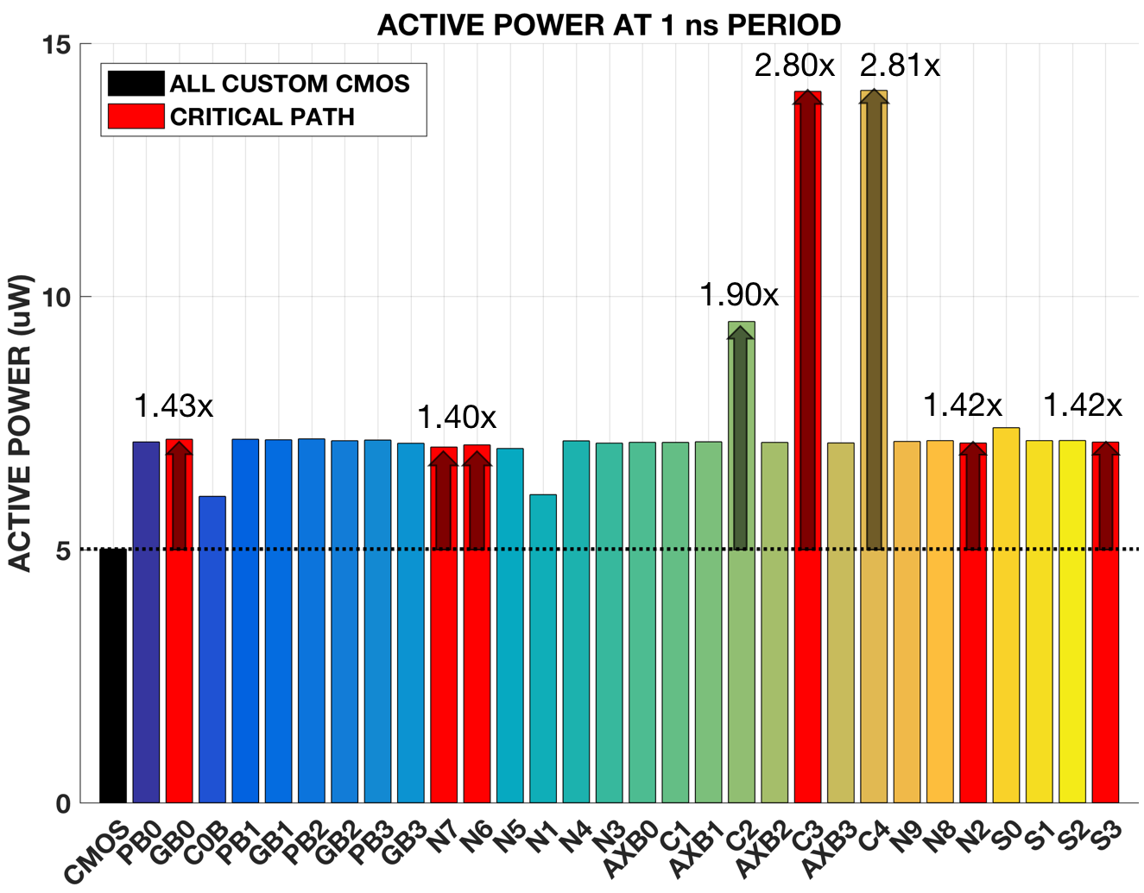
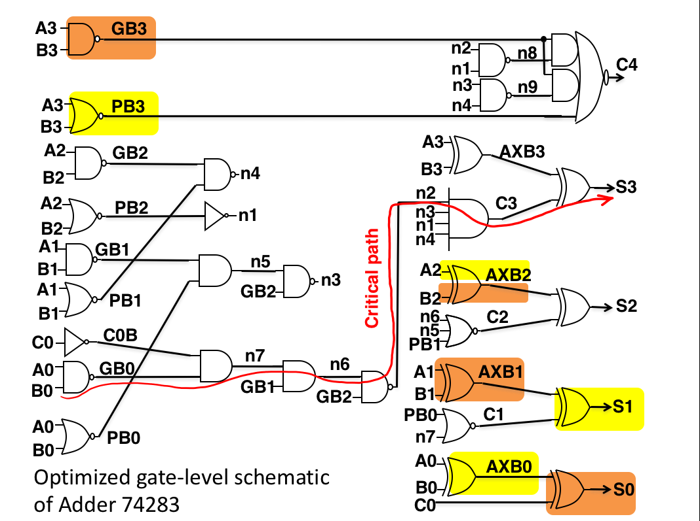
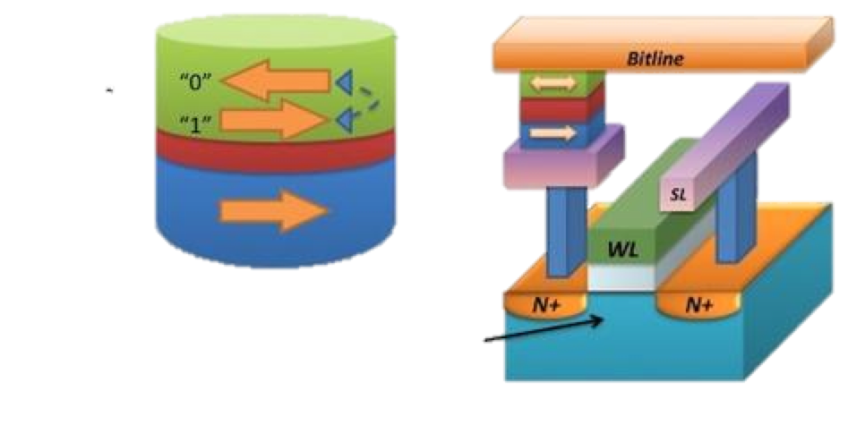
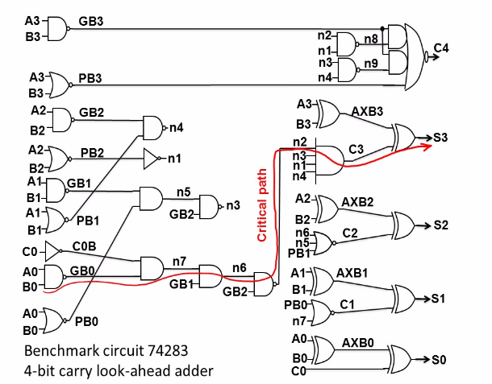
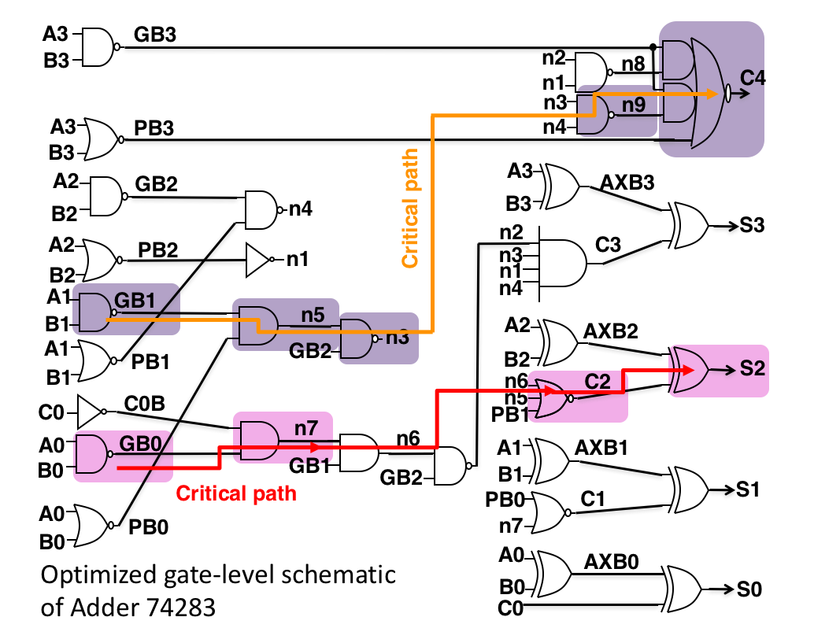
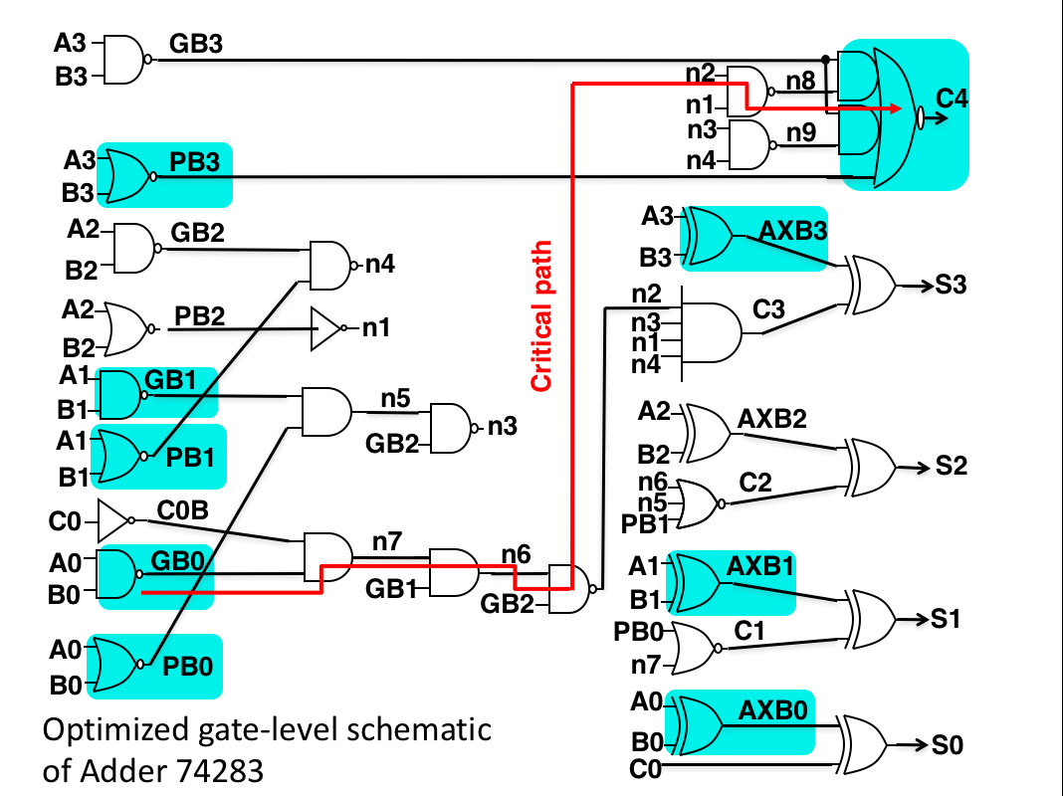
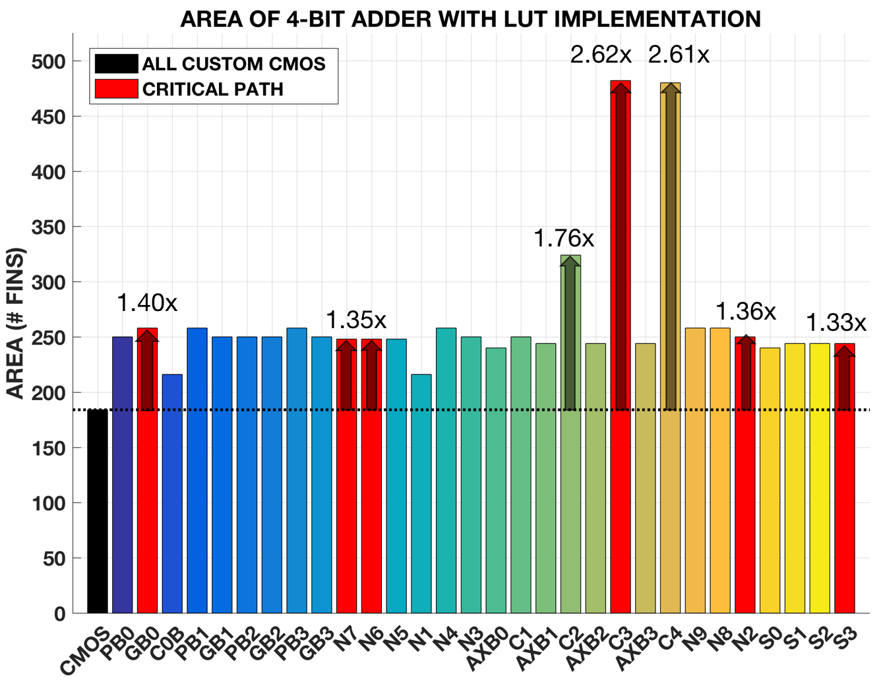
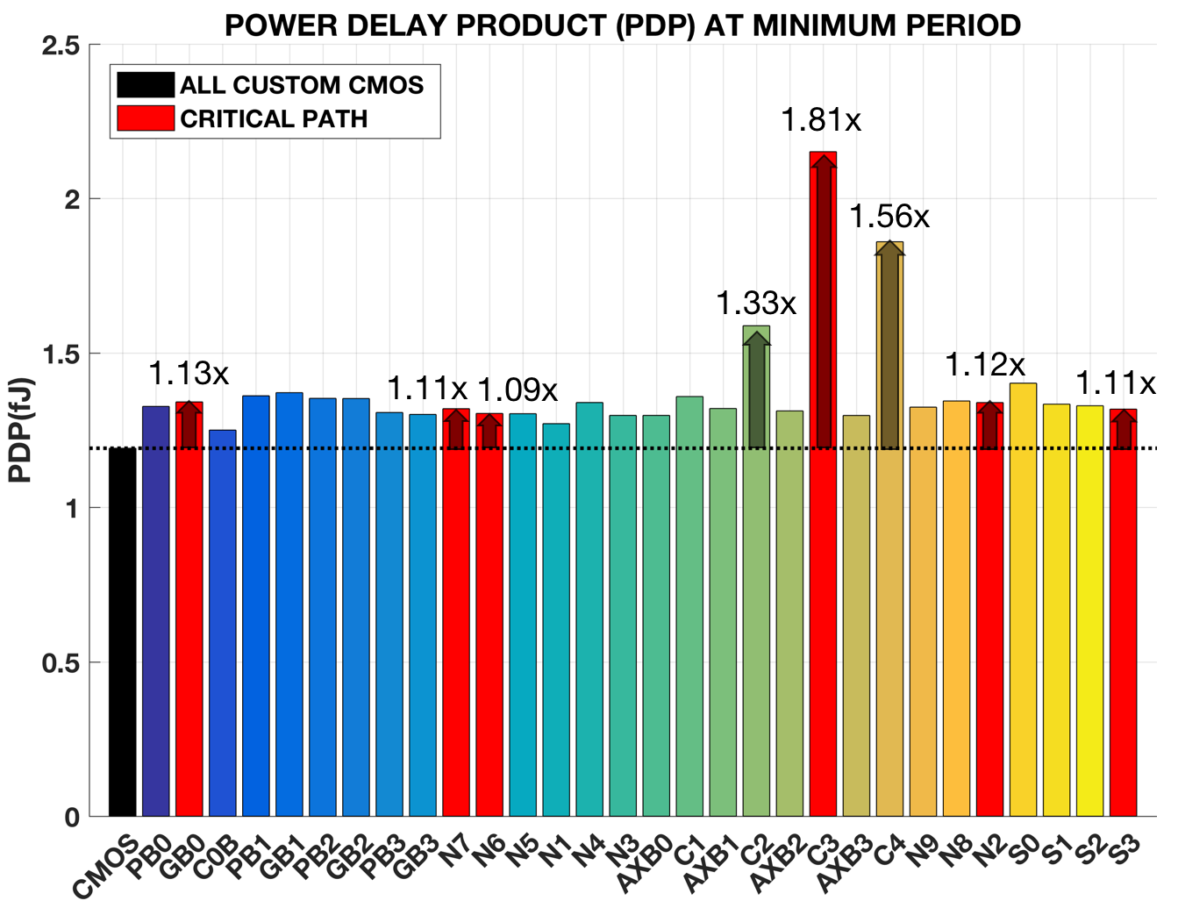
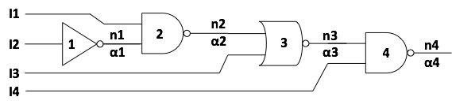
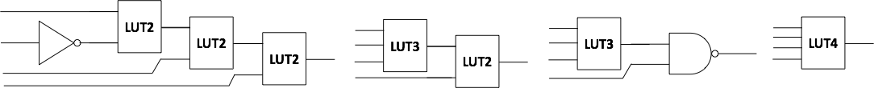
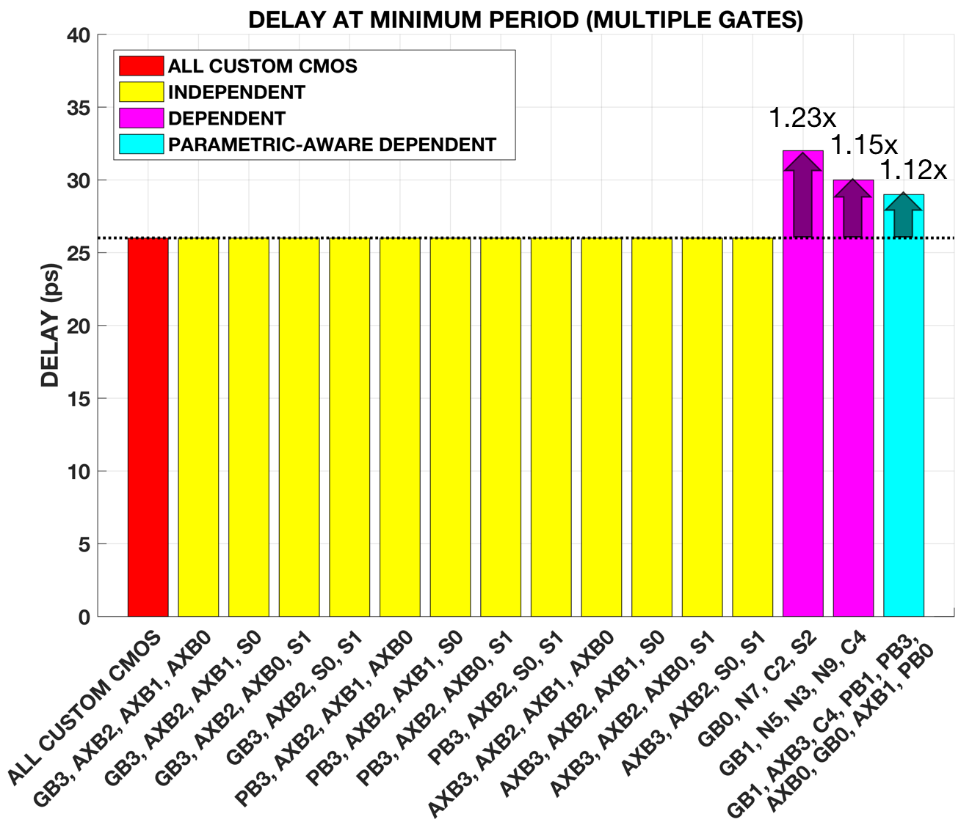
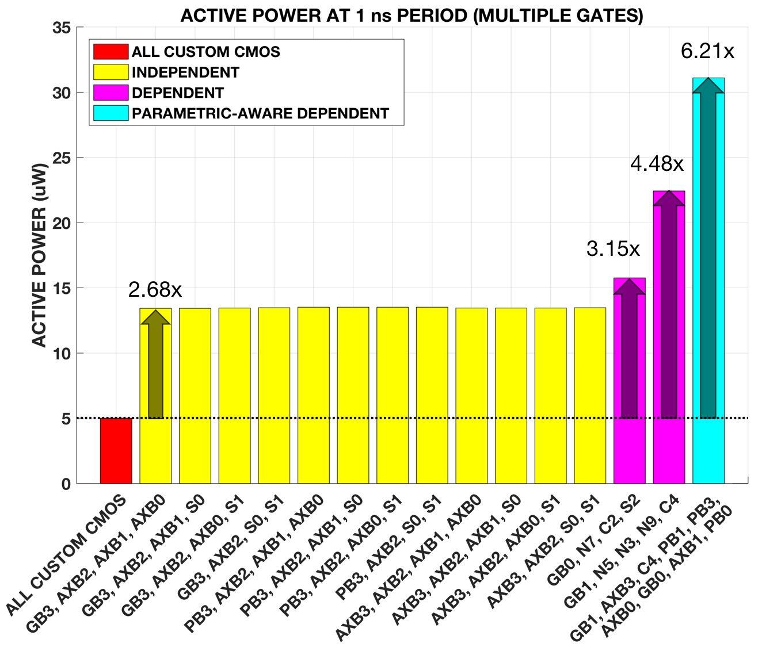
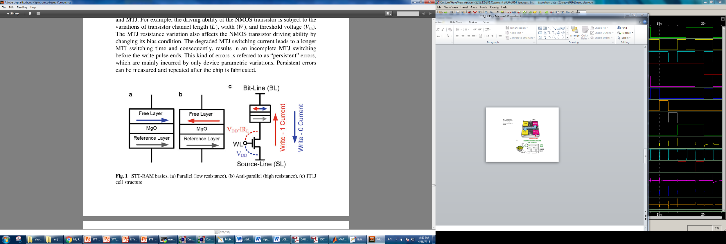
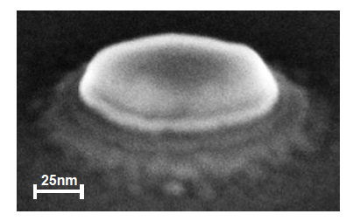
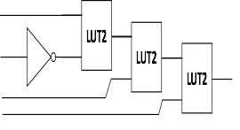
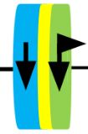
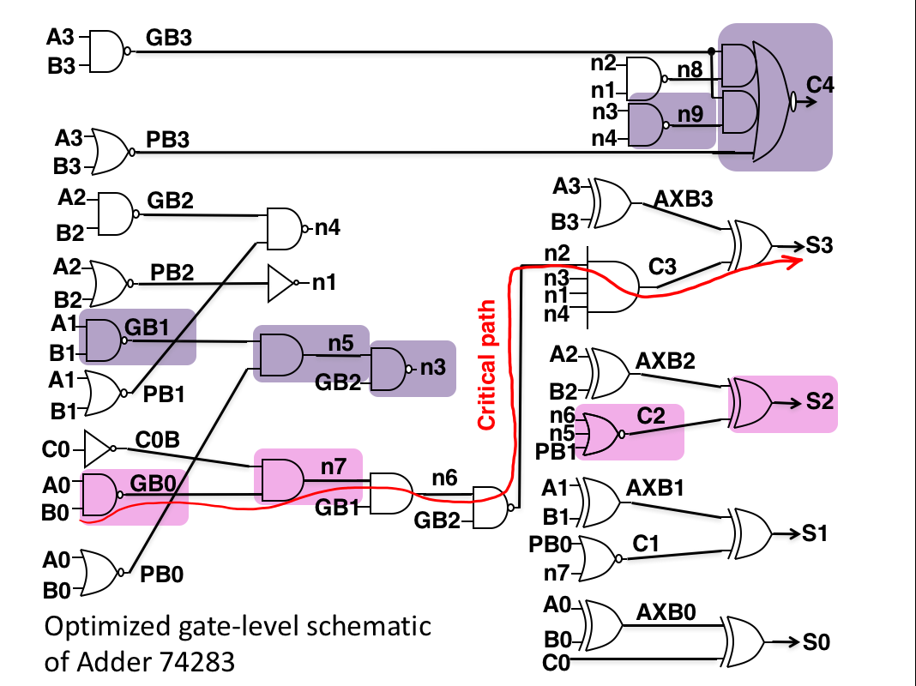
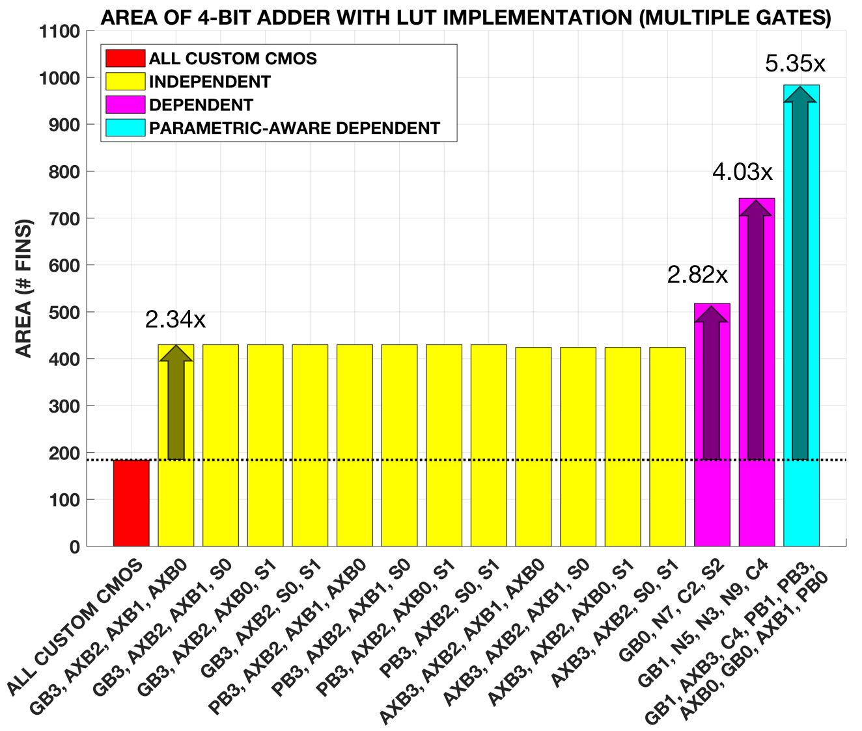
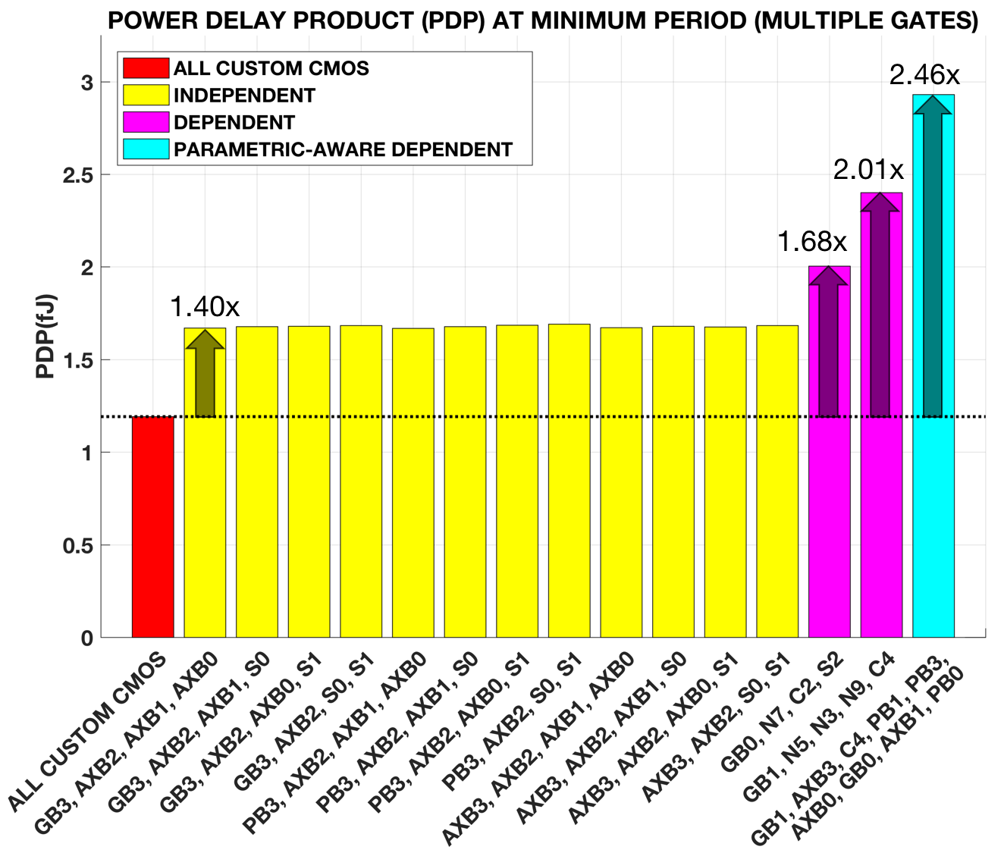
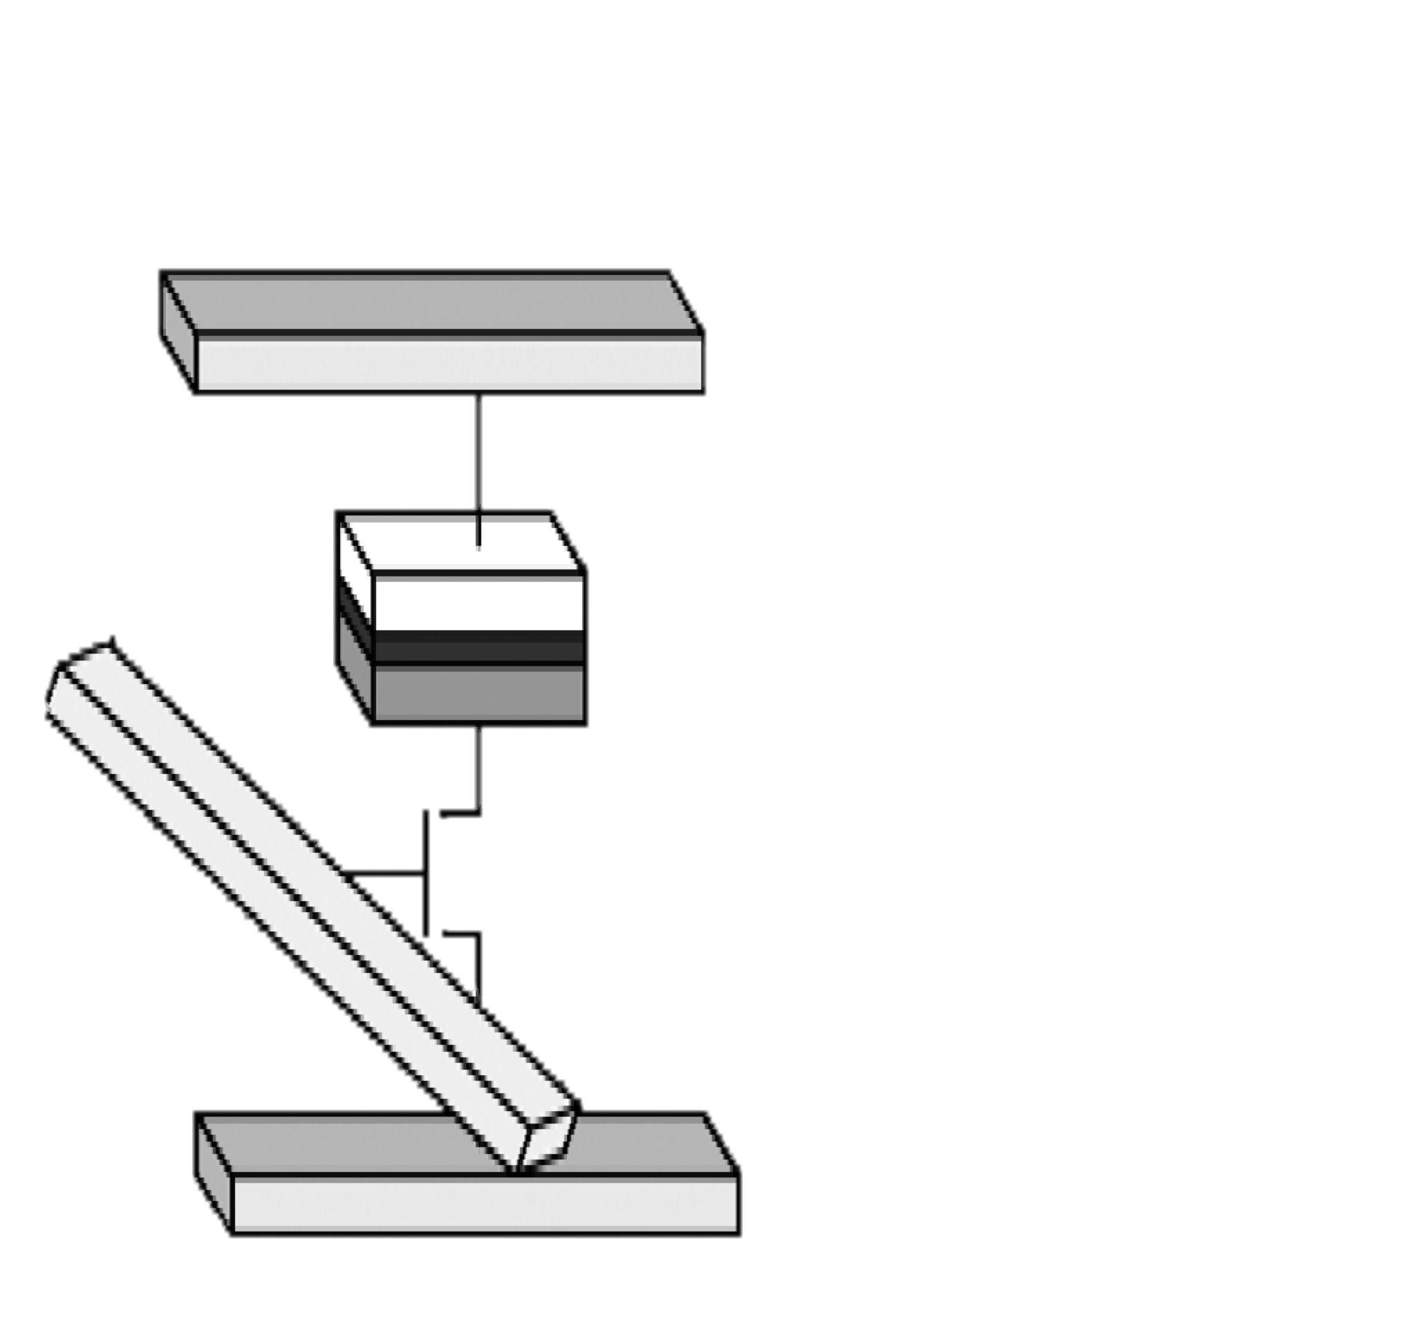
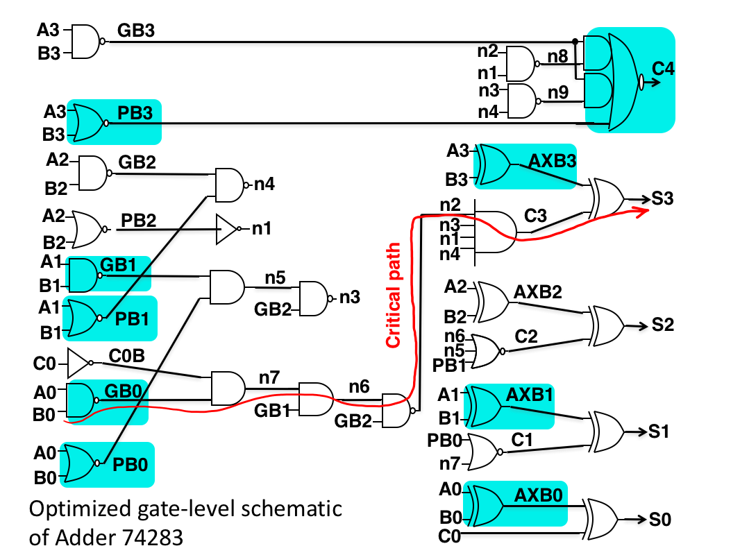
Efficient Logic Design Using Spin Transfer Torque Memory Technology & Lookup Tables
Brandon Leung¹, Yu Ting Huang¹, Fernando Lorenzo¹, Sergio Rodriguez¹, Janine Young¹
Graduate Mentor: Aliyar Attaran², Advisor: Hamid Mahmoodi²
¹Cañada College 4200 Farm Hill Blvd. Redwood City, CA 94061
²San Francisco State University: Dept. of Engineering 1600 Holloway Ave. San Francisco, CA 94132
Research Goals
Logic Implementation using STT-LUT
Individual Gate Mapping Results
Change in Critical Output
Hybrid design of logic circuits using custom CMOS and STT-LUTs
Optimal hybridizations that utilizes efficiency of custom CMOS and programmability of Lookup Tables
Experiment this optimization on adder test circuit
Contents of STT-LUTs can be programmed to implement any arbitrary logic function
STT-LUTs improve security and are non-volatile
Require more time, power, and transistors to operate
All the 30 gates in the 4-bit adder were individually mapped to measure the time delay, active power consumption, area and power delay product. Data is then compared to that of all Custom CMOS.
The critical output is the indication of where the critical path ends. When mapping the gates, we also focused on the whether or not the critical output changes. This change in the critical output meant that the critical path had changed as well; this tells us which specific mappings cause significant delay.
Spin Transfer Torque Random Access Memory (STTRAM)
Critical path does not change when mapping independent selections
Critical path changes when mapping dependent and parametric-aware dependent selections
Case Study: 4-bit Adder
STT technology offers non-volatile information storage using Magnetic Tunnel Junctions (MTJ)
Offers more flexibility compared to current information storage technology such as DRAM, SRAM
Reconfigurable memory technology
Gate-level schematic of 4-bit adder showing the critical path, which is the pathway with the most delay and passes the most number of gates
LUT replacement of all the gates on the critical path causes delay overhead
LUT replacement of some non-critical gates results in delay overhead and change of the critical path
LUT replacement of a gate may result in delay overhead
LUT replacement of any gate results in power overhead
Magnetic Tunnel Junction
Conclusion
Composition
2 ferromagnetic layers Includes:
Free layer - magnetic field orientation can be changed
Fixed layer - magnetic field orientation cannot be changed
Oxide barrier
Used to store information
Information is sensed as resistances
Resistance is sensed by applying a current to MTJs layers
Low resistance is logic state 0
High resistance is logic state 1
Individual Gate Mapping
Independent selection causes no delay overhead and uses the least power to operate but is the easiest to reverse-engineer. Dependent selection is more difficult to reverse-engineer but shows the longest delay overhead. Parametric-aware dependent selection is more difficult to reverse-engineer than independent and has less delay than dependent but requires more power. Depending on the designer’s preference, a different algorithm would be selected. If performance is prioritized over all else, the independent selection algorithm would be used. If the main purpose of the hybrid design is to improve security while minimizing power, the dependent selection should be applied. If power consumption is not an issue, parametric-aware dependent selection would be used since it offers more reconfigurabilty with some delay.
Each logic gate can be replaced by Lookup Table programmed with the corresponding truth table of the logic gate
Simulate and extract data from each mapped gate
LUT replacement of any gate results in area increase
PDP is the most accurate way to compared all the mapped gates
I3
I4
Multiple Gate Mapping Results
Multiple Gate Mapping
Multiple gates were selected using the algorithms and the individual mapping results. Most gates that produced delay overhead were not selected. Selected gates with delay overhead were chosen to protect vulnerability.
Map multiple gate simultaneously and extract data
Three optimization algorithms
Independent Selection
Dependent Selection
Parametric-Aware Dependent Selection
References
[1] Almasi, D., Enhancing Hardware Security Using Spin Transfer Torque Logic, in Engineering of Embedded Electrical and Computer Systems. 2015, San Francisco State University: San Francisco.
[2] Mano, M. Morris and Kime. Charles R. Logic and Computer Design Fundamentals. New Jersey: Pearson Education, 2008. Book.
[3] Winograd, T., et al., Preventing design reverse engineering with reconfigurable spin transfer torque LUT gates, in 17th International Symposium on Quality Electronic Design. 2016, IEEE: Santa Clara, CA. p. 242-247.
[4] C. Augustine et. al., “Spin-Transfer Torque MRAMs for Low Power Memories: Perspective and Prospective,” IEEE Sensors Journal, vol. 12, no. 4, pp. 756 – 766, 2012.
[5] Almasi D., Mahmoodi, H. Homayoun, H. Salmani, H. “Device and Circuit Optimizations for Spin Transfer Torque Reconfigurable Logic”
STT-RAM basics: (a) Parallel (Low Resistance). (b) Anti-parallel (high Resistance). (c) 1T1MTJ cell structure [Weisheng Zhao, 2015]
Microscopic view of MTJ
[T. Kawahara, Microelectronics Reliability Jr.]
STT Based Look Up Table (STT-LUT)
Independent Selection
Independent selection produced no delay overhead
Randomly select gates in which their paths do not intersect
Parametric-aware dependent selection required the most power
STTRAM cell
bit line
word
line
source line
Mux
Each STT-LUT consists of a number of multiplexers and STTRAM
Dependent Selection
Gates that are along the same path or subsequent to each other are mapped
Mux
output
Acknowledgments
Mux
Each MUX consists of a number of logic subcircuits
Parametric-Aware Dependent Selection
n selector inputs
This project was partly supported by the US Department of Education through Minority Science and Engineering Improvement Program (MSEIP, Award No. P120A15014), and the Hispanic-Serving Institution for Science, Technology, Engineering, and Mathematics (HSI STEM) Program, Award No. P031C110159.
[Hamid Mahmoodi, 2016]
Gates that do not greatly impact delay are mapped
Parametric-aware dependent selection occupies the most area
Parametric-aware dependent selection rated highest in PDP

